Slide 1
Optical Networks [EENGM0003]
Dr. George T. Kanellos
[gt.kanellos@bristol.ac.uk]

Slide 2
Session Outline
Reconfigurable Add/drop Multiplexers
Wavelength Selective Switches
Types of ROADM
Optical cross-connects
MEMS Switches
Wavelength Selective Cross-Connect (WSXC)
Wavelength Interchange Cross-Connect (WIXC)

Slide 3
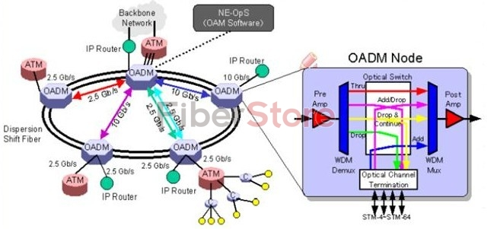
OADM enable ring topology

Slide 4
Key parameters for OADM
total number of wavelengths
maximum number of wavelengths that can be dropped/added
constraints on whether speciﬁc wavelengths can be dropped/added
How easy is it to add and drop additional channels?
Is the architecture modular, in the sense that the cost is proportional to the number of channels dropped?
What is the complexity of the physical layer
Is the OADM reconﬁgurable?

Slide 5
Reconfigurable OADM
Reconﬁgurability is a very desirable attribute in an OADM
Reconﬁgurability refers to the ability to select the desired wavelengths to be dropped and added on the fly, as opposed to having to plan ahead and deploy appropriate equipment.
This allows carriers to be flexible when planning their network and allows lightpaths to be set up and taken down dynamically as needed in the network.
It enables optical wavelengths to be redirected to client interfaces on just a click in the software. Other traffic remains unaffected by this.

Slide 6
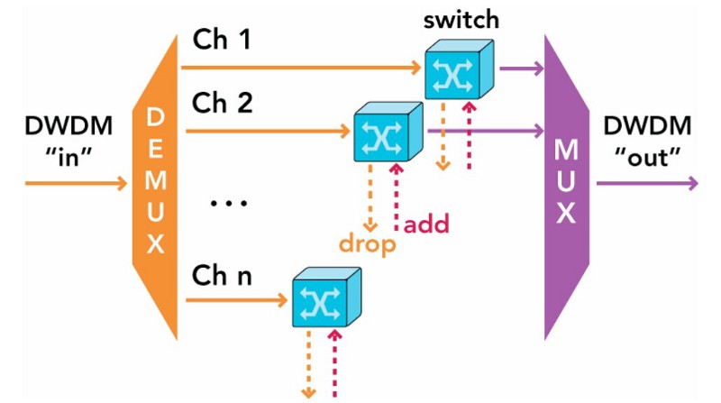
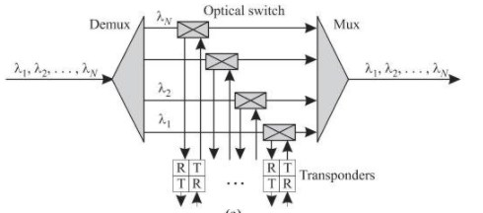
ROADM I
a variation of the parallel architecture.
It uses optical switches to add/drop speciﬁc wavelengths as and when needed.
Fixed wavelength transponders
need to deploy the transponders ahead of time
expensive to have a transponder deployed and not used
need to decide ahead of time as to which set of wavelengths we will need to deploy transponders

Slide 7
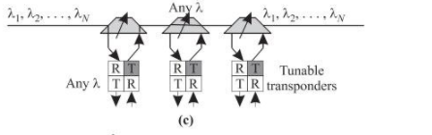
ROADM II
tunable transponder:
can be set to transmit/receive at any desired wavelength
uses a tunable WDM laser and a broadband receiver capable of receiving any wavelength.
Serial architecture with optical add/drop switches and tunable wavelength transponders
Each tunable SC-OADM is capable of adding/dropping any single wavelength and passing the others through, as opposed to a ﬁxed wavelength
provides a fully reconﬁgurable OADM

Slide 8
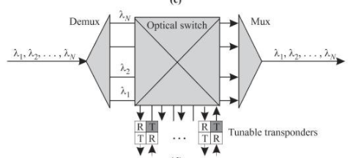
ROADM III
Fully tunable ROADM using parallel architecture with tunable transponders
Use of large optical switch
Is practically an optical crossconnect

Slide 9
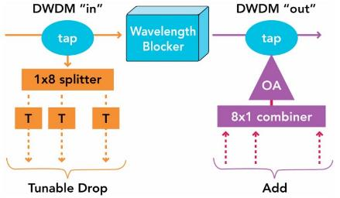
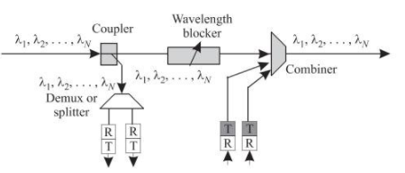
ROADM with WB
Broadcast and select ROADM
Passive optical coupler splits signal in drop port and demultiplexed
Other part sent through
Wavelength blocker: reconfigurable device that can selectively block or passthrough individual wavelengths

Slide 10
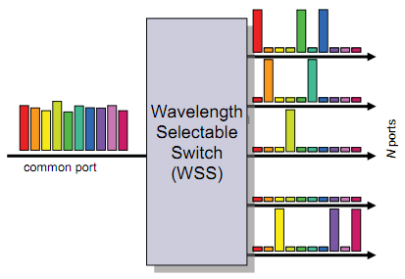
The ROADM Heart – the WSS Module
Wavelength selective switch
MUX
The basic element of the third generation ROADM
WSS: users can dynamically drop any wavelength to any port and then change drop capacity as needed
flexible channel plan together with dynamic per-channel power equalization
DEMUX

Slide 11
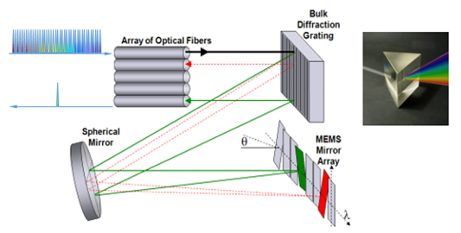
WSS principle of operation

Slide 12
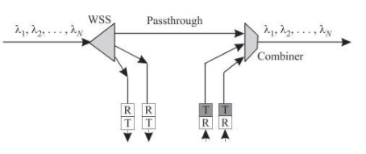
ROADM with WSS
ROADM implemented using a 1×N wavelength selective switch (WSS)
The 1×N WSS is connected to the input of the ROADM, and one of the outputs of the WSS is the passthrough to the output of the ROADM.
The other N − 1 outputs of the WSS are used to drop wavelengths locally.
These outputs are sometimes referred to as colorless because they can carry any wavelength.
Wavelengths of local tunable transmitters of the ROADM can be added to the output of the ROADM using a combiner, for example, an optical coupler

Slide 13
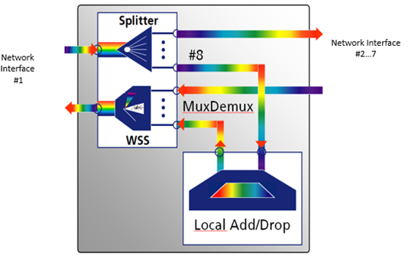
3rd Gen ROADM
fiber in is fed to the wavelength splitter.
all the wavelengths are available at all output ports of the splitter
Local add/drop traffic (wavelengths) can be multiplexed/de-multiplexed
The remaining splitter ports are connected with other network directions, for example, three other directions at a 4-degree junction node
WSS selectively joins the various wavelengths and feeds them to the output of network interface #1

Slide 14
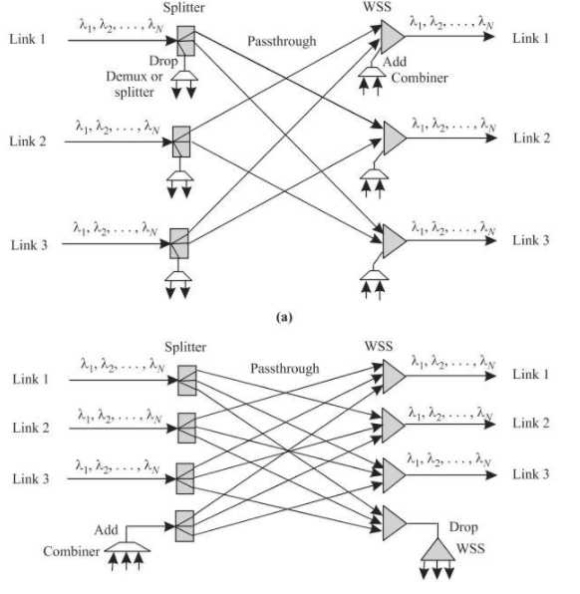
Multidegree ROADM using WSS

Slide 15
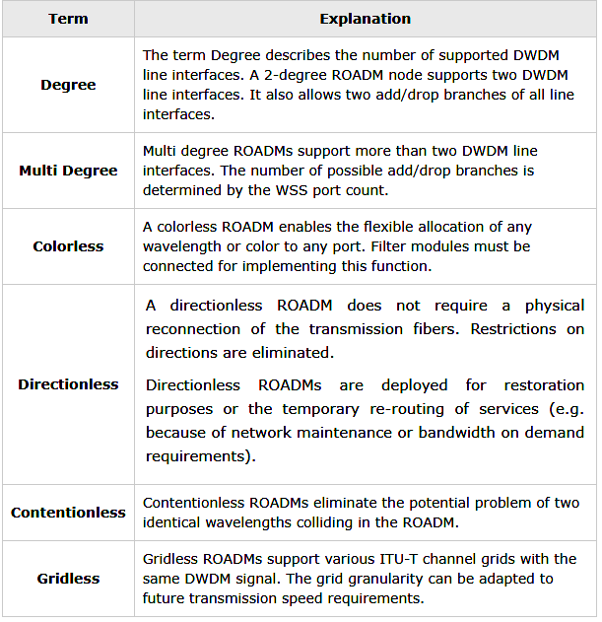
ROADM – Degrees, Colorless, Directionless

Slide 16
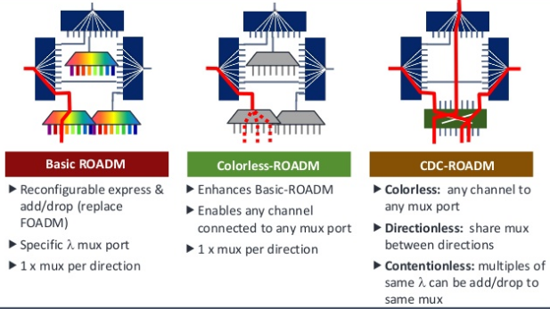
The ROADM evolution

Slide 17
C/D/C ROADM
Colored / Directed
Colored / Directionless
Colored / Directionless
Colored: fix transponders/AWG
Directed: Each add/drop attached to one NI
Colored: fix transmitters
Directionless: WSS attached to receivers (thus choose which wavelength from which fiber to be terminated)

Slide 18
Colorless / Directed
Colorless: tunable transponders
Directed: each NI has attached an add/drop terminal

Slide 19
Colorless/Directionless/Contentionless
Directionless: add/drop terminals connected with all NI
Colorless: tunable transponders
2 stage WSS
Contentionless: add another add/drop terminal

Slide 20
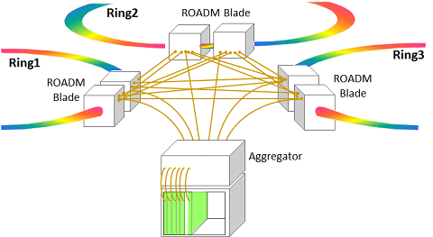
Flexible, Robust and Cost-effective Networking
The multi-degree CDC (Colorless, Directionless, Contentionless) ROADM capability allows operators to assign any wavelength/direction to the output of a given transponder by software.

Slide 21
Evolution of the Optical Networks
Mesh/Rings with reconfigurable OADMs and Optical Cross-Connects (OXCs)
Interconnected rings
OXC
and mesh topologies
OXC
OXC
OXC
OXC
WDM rings with
full connectivity
OADM
OADM
OADM
Rings with reconfigurable Optical Add/Drop Multiplexers (OADMs)
WDM rings with
OADM
Technology evolution
OADM
node addressing
OADM
Rings with static Optical Add/Drop Multiplexers (OADMs) and tuneable transponders.
OADM
OADM
OADM
OADM
WDM transmission with add/drop
Point-to-point wavelengths with static Optical Add/Drop Multiplexers (OADMs)
OADM
OADM
WDM transmission
Point-to-point fibre
Time
Present
Future

Slide 22
Optical Networks [EENGM0003]
Dr. George T. Kanellos
[gt.kanellos@bristol.ac.uk]

Slide 23
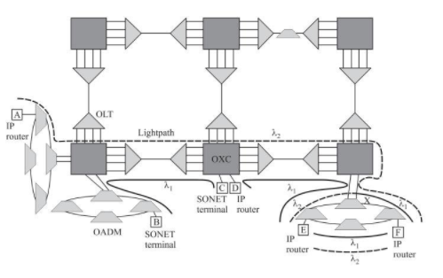
Complete WDM network

Slide 24
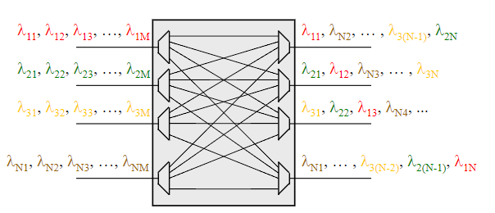
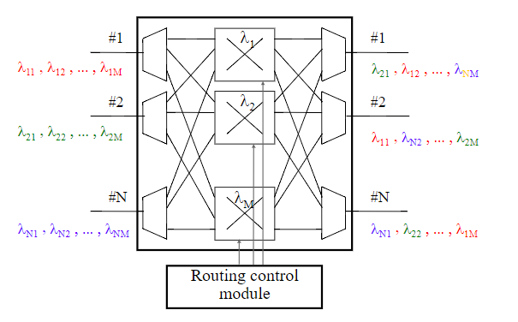
Static vs Dynamic Cross connect
Static cross connect
Dynamic cross connect
Dynamic wavelength routing implies that the internal cross-connect field within the node can be changed dynamically. This allows the routing pattern to be changed automatically.

Slide 25
Dynamic Cross Connect (Wavelength Router )
n x n dynamic cross-connect switch
(n fibres, m wavelengths)
space switch
λ
,
λ
,
.
.
.
λ
λ
1
1
2
m
λ
,
λ
,
.
.
.
λ
n
x
n
1
2
m
1
λ
2
1
λ
m
n
x
n
2
2
n
n
n
x
n

Slide 26
Dynamic Cross Connect (Wavelength Router )
Consider n x n node with n input and output fibres, each can carry up to m distinct wavelengths
The purpose of the cross-connect is to allow a wavelength on any input fibre to be connected to any outgoing fibre
Each input fibre is connected to an 1 x m wavelength demultiplexer, which separates out all the wavelengths. Similarly each output fibre is connected to a wavelength multiplexer that combines the different wavelengths to the corresponding output fibre.
There are nxm fibres and they are wired in such a way that prevents identical wavelengths from different ports to be combined on the same output port
The path that a signal takes through the network is uniquely defined by the wavelength of the signal and the port through which it enters the network, e.g. the wavelength to go from input port 2 to output port 1 is l₂

Slide 27
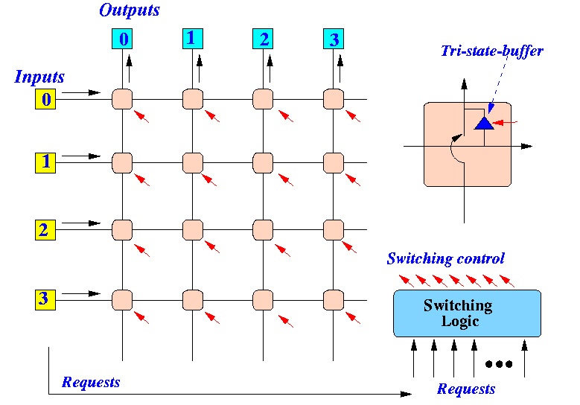
Cross bar switches

Slide 28
Optical Space Switching Technologies :MEM
MEMS (Micro-electro-mechanical systems) are miniature mechanisms fabricated from semiconductor materials such as silicon
Comprise tilting mirrors arranged in either 2D or 3D geometries
In 2D array, mirrors move up and down forming a cross-bar switch
In 3D arrays mirrors can be tilted in any direction.
The arrays are arranged in pairs, facing each other, and at an angle of 90 degrees to each other
Incoming light is directed onto a mirror in the first array which deflects it onto a predetermined mirror in the second
This in turn deflects the light to the predetermined output port.

Slide 29
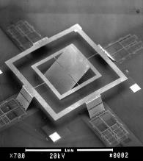
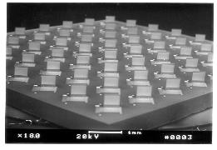
2 - D MEMS Switches
NxN switch: N² mirrors
Simple control electronics
Planar free-space approach
High loss for large switch matrices

Slide 30
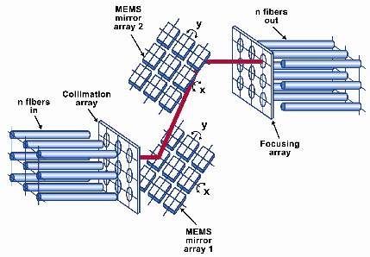
3 - D MEMS Switches
Source: Xerox PARC
256 - 1,000 ports
3D Micro-electro-mechanical systems (MEMS)
Scales with 2N
256 x 256 requires 512 mirrors only
But: complex concept, availability
But: very good research !
0.3 - 1 mm

Slide 31
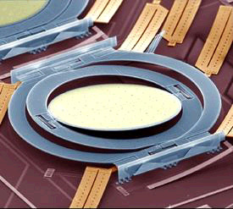
Example Lucent 3D MEMS Switch
Mirror adjustment/control (several analogue drive voltages):
1) Coarse adjustment with no feedback (attenuation < 10 dB)
2) Fine adjustment with closed feedback loop (attenuation < 3 dB).
Required precision:
Hit a cent coin with a laser from 2 km distance!
Source : Lucent

Slide 32
MEMS Technology : Features
MEMS mirrors: gold coated silicon, electrostatically actuated
mSec switching speed
Wide wavelength range (1290 - 1620 nm)
Low insertion loss
Low crosstalk
Scalable to large switch sizes
Suitable for other applications (e.g. variable optical attenuators, spectral equalization)
Scalability
2D subsystems scale to 32x32
Multiple 2D scale to 512x512
3D scale to >1000x1000

Slide 33
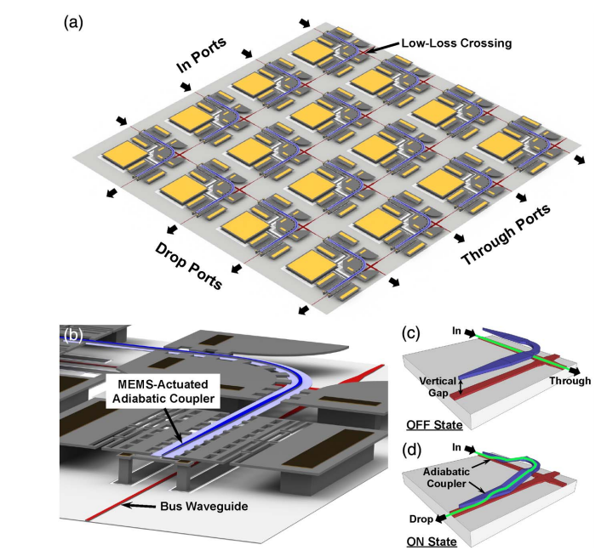
Silicon integrated 2D MEMS switch
Size: up to 128x128
Speed: <1μs

Slide 34

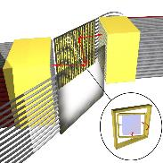
Optical MEM Switches Comparison of Different Architectures
2D-MEMS small sizes:
single matrix 8x8, 16x16, 32x32
N² elements - insertion loss & variations
2D-MEMS medium sizes:
3 stage Clos 64x64, 128x128, 256x256
4√2N^{1.5}..6√2N^{1.5} elem. + modularity
- cabling
- insertion loss & variations
3D-MEMS medium...large sizes:
single matrix 32x32 ... 1024x1024
2N elements + insertion loss
- modularity
- 2 dimensional analog control
1
1
1
2
2
2
...
...
...
k
k
k
n x 2n 2n x2n 2n x n

Slide 35
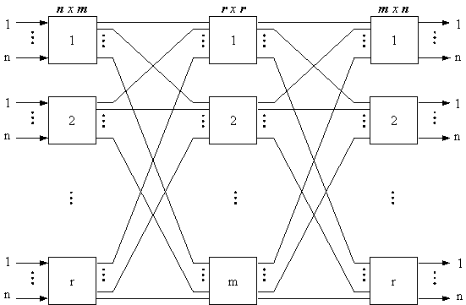
Clos Network
Make a bigger switch out of smaller switches
m ≥ 2n−1
strict-sense nonblocking, meaning that an unused input on an ingress switch can always be connected to an unused output on an egress switch
m ≥ n
rearrangeably nonblocking, meaning that an unused input on an ingress switch can always be connected to an unused output on an egress switch, but for this to take place, existing calls may have to be rearranged by assigning them to different centre stage switches in the Clos network

Slide 36
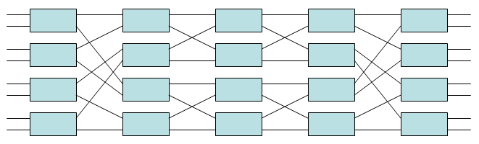
The Benes switch
m = n = 2
use a total of N log₂N − N/2 2×2 crossbar switches
2 log₂N − 1 stages
each containing N/2 2×2 crossbar switches

Slide 37
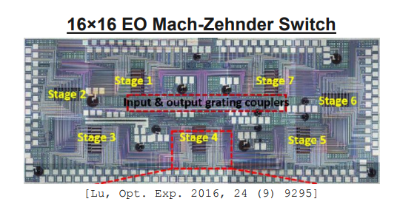
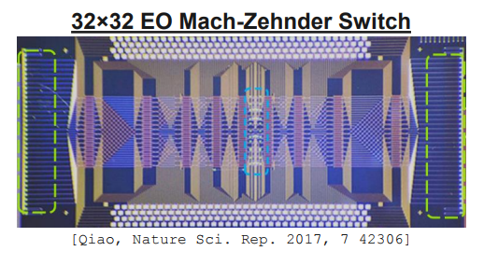
Other switching technologies
Switching in Silicon!!!
3.2/2.5ns
2016
1/1.2 ns
2017

Slide 38
Dynamic Cross Connect (Dynamic Wavelength Router)
is achieved through the use of space switches.
The n x n space switch allows a signal entering at any wavelength at an input port to be switched to any output port, with the signal remaining at the same wavelength
m input wavelength channels are on each input fibre are spatially separated into m layers by wavelength demultiplexers.
Each wavelength layer is connected to one space switch (e.g. λ₁ layer is the upper switch) which switches m signals of the same wavelength, one from each input fibre
Then the switched wavelength channels are recombined by wavelength multiplexers to the output fibres.

Slide 39
Wavelength Interchange Cross-Connect (WIXC)
Large switch: (MxN +Add) x (MxN+Drop)
Needs to be installed from day 1 - expensive
λ1
λ1
λ1- λN
λ1- λN
1
1
λN
λN
λ1
λ1
λ1- λN
λ1- λN
M
M
λN
λN
M Demultiplexers have to be the size of the maximum number of wavelengths in WDM system from day 1 (ie λN)
1
Add
M Multiplexers have to be the size of the maximum number of wavelengths in WDM system from day 1 (ie λN)
1
Drop
Add/Drop
TX
TX
RX
RX
Wavelength conversion/regeneration or path to electrical layer (SDH DXC/IP routers…..)

Slide 40
Wavelength Selective Cross-Connect (WSXC)
“Lamda” switches: switch size = (M+K) x (M+K)
Number of switches = number of used wavelengths = “pay as you grow” architecture (incremental cost)
Needs to be installed from day 1
Fibre shuffle
λ1
λ1
λ1- λN
M
M
λ1- λN
1
1
λN
K
K
λN
λ1
λ1
λ1- λN
λN
λ1- λN
M
M
λN
λN
M Demultiplexers have to be the size of the maximum number of wavelengths in WDM system from day 1 (ie λN)
M Multiplexers have to be the size of the maximum number of wavelengths in WDM system from day 1 (ie λN)
Fibre shuffle
Add/Drop
TX
TX
RX
RX
Wavelength conversion/regeneration or path to electrical layer (SDH DXC/IP routers…..)

Slide 41
WIXC versus WSXC
WIXC architecture provides any-to-any connectivity. However, this is superfluous since input λ1 cannot be switched to λ2 without first dropping to a wavelength converter
WSXC architecture is more suitable to WDM since only allows same wavelength to same wavelength switching – more efficient use of switch matrix
WIXC architecture requires very large switch from day one – expensive initial cost even if only a few wavelengths are used. This would certainly not be constructed using 2D MEMS – more likely to be 3D (or Clos arrangement of 2D MEMS, but high loss + expensive)
WSXC architecture is a modular design utilizing many small switches that are installed only when necessary – smaller initial cost: “Pay as you grow” architecture. Small switches imply 2D MEMS would be more appropriate than 3D MEMS. 2D switch technology more mature than 3D

Slide 42
Optical Crossconnect (I): Wavelength Modular
Wavelength demultiplexing can be achieved with a static demultiplexer - simplifies input stage
OXC is wavelength modular, but not link modular
Strictly non-blocking
Maximum add/drop flexibility provided sufficient Tx’s and Rx’s available
Wavelength Demultiplexers
Combiners
WC
1-M
1
1-M
1
1
1-M
1-M
1-M
1-M
N_{f}
N_{f}
EDFA
Optical Path Layer
M
Digital Path Layer
Tx
Rx
Digital Cross Connect

Slide 43
Optical Crossconnect (II): Link Modular
WC
1-M
Combiners
Wavelength demultiplexing achieved with a static demultiplexer
Strictly non-blocking
Link modular
Maximum add/drop flexibility provided sufficient Tx’s and Rx’s are available
1
1-M
1
1-M
1-M
1-M
N_{f}
EDFA
1-M
N_{f}
Optical Path Layer
Digital Path Layer
Tx
Rx
Digital Cross Connect

Slide 44
End of session 5
Any questions?

